Slide 1




Internship Report
Mahindra and Mahindra
NAME : Kunal V. Sonawane.
ROLL NO. : BT18MEC064.
TITLE : Analysis And Maintenance of Automobiles.
GUIDE : Sagar Kau.
COLLEGE : Visveswaraya National Institute Of Technology, Nagpur.
DURATION : 17th June – 31st July.
LOCATION : Jitendra Motors – Mahindra, Pathardi Phata, Nashik -422010.
Kunal V. Sonawane Sagar Kau
(Internship Guide)

Slide 2
Objectives
Studied and Implemented the Assembly of 2.2L mHawk Engine and Open-Differential.
Observe and study the troubleshooting and Maintenance of Vehicles and components.
Managed the Supply of Spare parts from the Inventory to Shop-floor under the guidance of Floor Coordinator.
Content
Engine Assembly 01
Engine Oil Change 19
Transmission Oil Change 20
Wheel Balancing 21
Disassembly of Differential 22
Miscellaneous 23

Slide 3
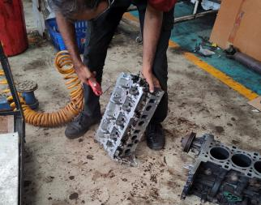
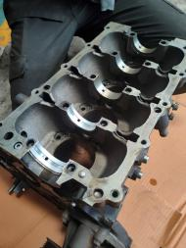
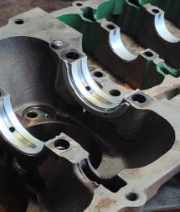
Engine Assembly
(2.2L, 4 cylinder Diesel engine (Xylo, XUV 500))
Clean and dry the engine components using compressed air gun.
Place journal bearing on the engine block and engine blade and the thrust washer on the side of journal bearing on engine blade.
(Thrust washers are used for reducing the crank shaft play inside the engine block and blade)
1

Slide 4
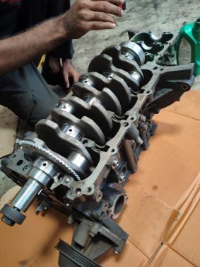
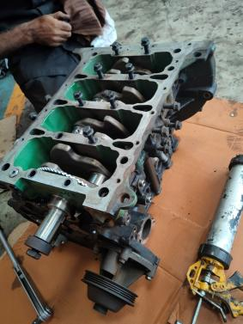
Place the crank shaft on engine block while applying oil for lubrication
Apply sealant on engine block and place the engine blade on top of it
2

Slide 5
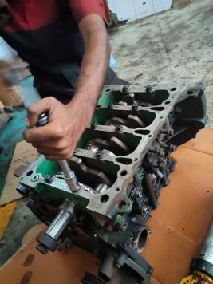
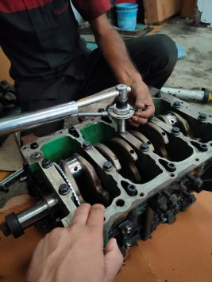
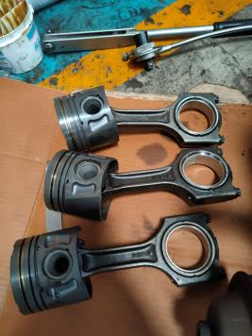
The bolts are tighten using torque wrench and angular torque wrench
(Every bolt has a specific Nm rating and degree rotation)
Assemble the connecting rod and pistons as per order using circlips and gudgeon pin
3

Slide 6
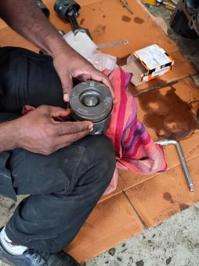
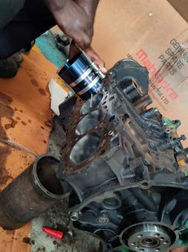
Piston rings are installed
(Note : Piston rings are placed nearly 120 degrees to each other so as to prevent pressure leakage)
Pistons are pushed into cylinder using piston ring compressor followed by installing the piston oil jets
4

Slide 7
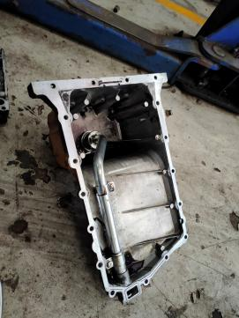
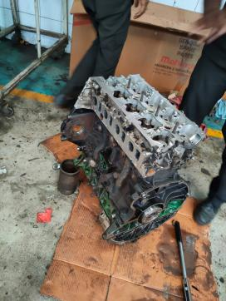
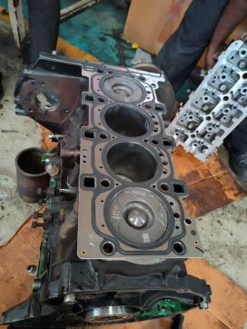
Next the oil sump is installed
(It works as a bowl/Reservoir for engine oil)
The engine is kept upright followed by placing the head gasket on top of it
5

Slide 8
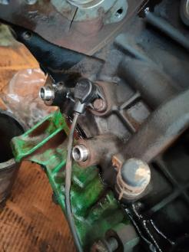
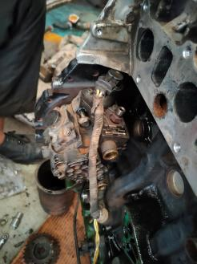
The Crank shaft sensor is installed
(It provides the ECU with crankshaft’s current position)
High Pressure pump is fitted next
(The high pressure pump maintains pressure in the common rail for fuel injection)
6

Slide 9
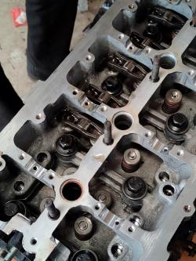
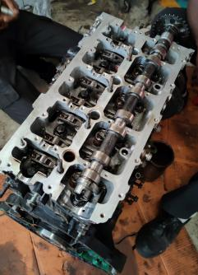
Place the hydraulic lashes on the valves situated on the engine head
(Lashes are used to open and close the inlet valve)
Place the inlet and exhaust cam shafts on the engine head
(Facing the timing side right side valves are inlet while the left side ones are outlet)
7

Slide 10
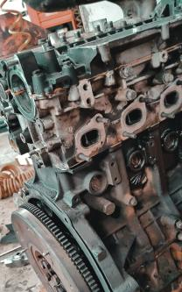
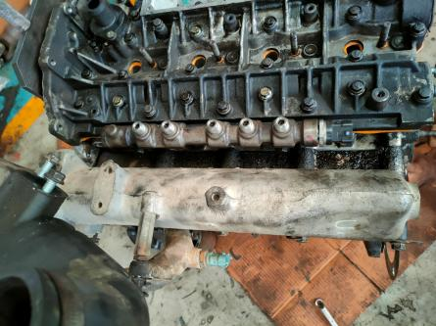
Valve cover is bolted after the placement of cam shafts
Intake manifold and common rail are installed next
Common rail maintains equal pressure in all the fuel injectors
Intake manifold provides equal amount of air supply for each cylinder
8

Slide 11
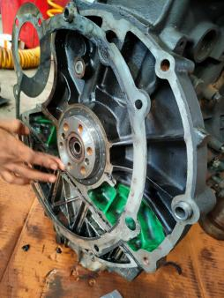
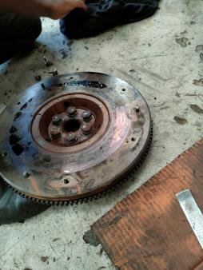
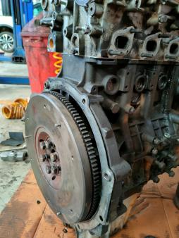
Oil seal is placed into its position using a hammer
Flywheel is installed on the end of the crank shaft besides the engine block blade
(Flywheel is used to maintain the rotation of engine, due to it’s high moment of inertia)
9

Slide 12
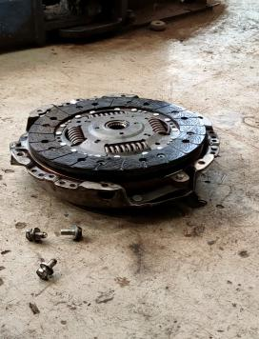
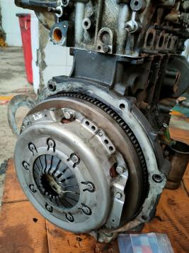
It is followed by pressure plate and clutch plate
(Pressure plate and clutch plate is used to engage and disengage the power from engine to gearbox while gear shifting)
10

Slide 13
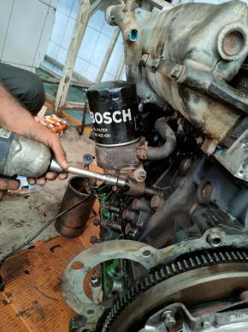
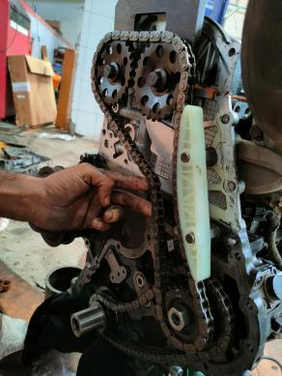
Oil cooler and oil filter is then fitted
(Oil cooler consist of copper tubes in which oil and coolant flows to exchange Heat)
Shining chains are installed next
(They are used to connect crank shaft to high pressure pump and cam shaft)
11

Slide 14
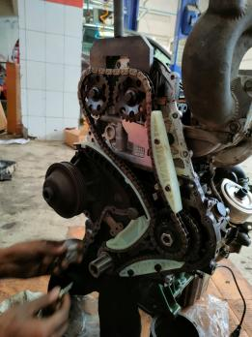
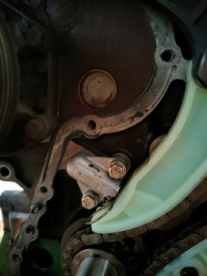
Set of arm tensioners are used to ensure tension and position of the chain followed by hydraulic tensioners
(Hydraulic tensioners work on the flow of engine oil, as the flow increases it presses the arm tensioners against the shining chain increasing its tension)
12

Slide 15
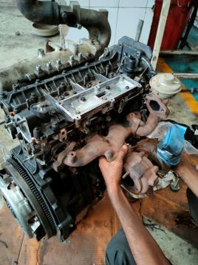
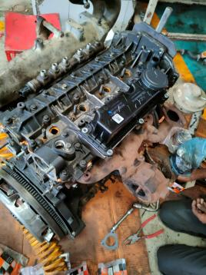
Place the exhaust gasket and install the turbo charger on the exhaust of the cylinders
(Turbo is used to increase the amount of air entering the combustion chamber by compressing air by extracting power from exhaust gasses)
13

Slide 16
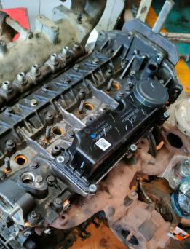
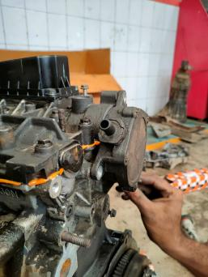
Oil mist separator is installed next
(It is used to remove oil vapors from the hot fumes mixture and direct the exhaust air to turbo while maintaining the oil in the engine by putting it back into sump)
Followed by oil mist separator, Vacuum pump is fitted
(It is used to maintain pressure in brakes, it drives its power from cam shaft)
14

Slide 17
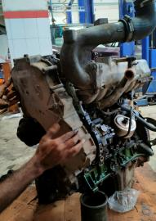
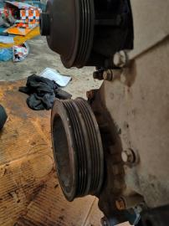
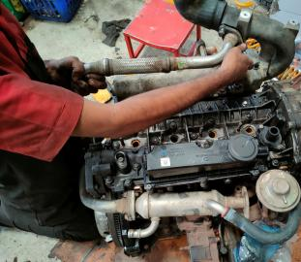
Timing cover is sealed and bolted next, followed by attaching the oil pump pulley to the timing cover (The cover consist of a oil pump which drives it’s power from crank shaft and circulates oil in the engine)
TIMING OF ENGINE : Before installation of timing cover both the inlet and exhaust cams are properly oriented, it is a very important step in the assembly of engine.
EGR (Exhaust Gas Recirculation) is attached to the turbo and inlet manifold
(EGR converts BS3 to BS4,It is used to reduce nitrogen oxide emission by directing some of the exhaust air to turbo and combustion chamber)
15

Slide 18
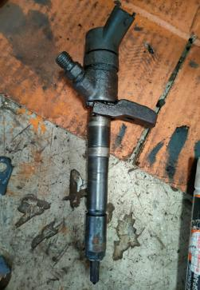
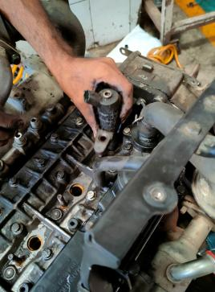
Fuel injectors are installed in specific order
Fuel injectors receive fuel from common rail which in-turn receives it from high pressure pump and is controlled by ECU
Fuel injectors have a dot marking for the order to be placed inside the engine head
16

Slide 19
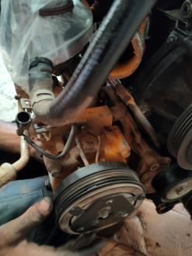
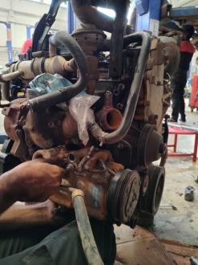
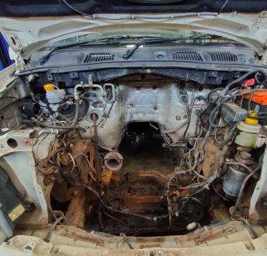
AC compressors is installed followed by the engine foundations which help mount the engine to the car
17

Slide 20
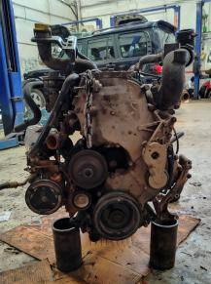
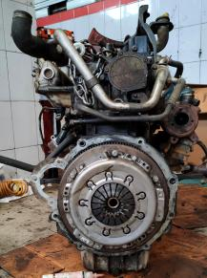
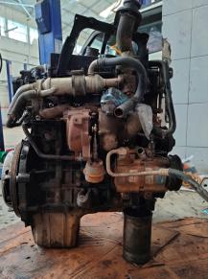
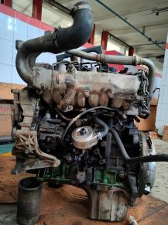
Final Assembly
Left Face
Right Face
Front or Timing Face
Rear End
18

Slide 21
Engine Oil Change
Car is mounted on the hydraulic lift and is lifted up
Oil collector is placed below the oil sump
Oil sump cap is opened using a box 10
After the oil is drained the washer is changed and the oil sump is then closed
5. Oil is changes using overhead oil tank( computer controlled)
6. Close the oil cap.
19

Slide 22
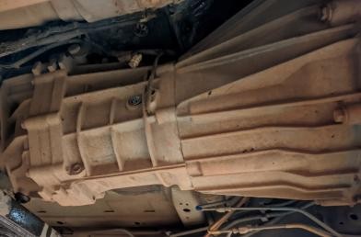
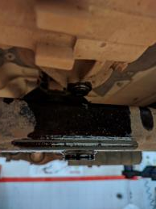
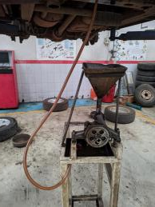
Transmission Oil Change
Car is mounted on the hydraulic lift and is lifted up
Oil collector is placed below the Gearbox
Gearbox bolt is opened using box 10 and the oil is drained.
Then the bolt is closed and side bolt is opened to replace the transmission oil.
Oil is then replaced using manual oil pump.
Side bolt is then closed.
20

Slide 23
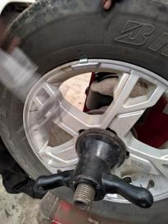
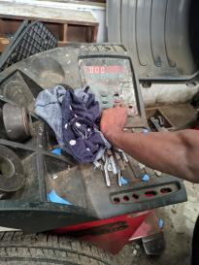
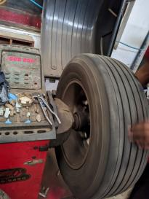
Wheel Balancing
Due to uneven wear of the tire the wheels deviate from their original balanced state , so as to keep them oriented balancing is required
All the gravels and stones are removed that might have stuck in the tire grooves
The wheel is then placed in a wheel balancing machine and locked in place.
Next we input the wheel radius and width and start the machine
After the process, the screen displays the location and weight to be added on the tire
Then, the given weight is added to the provided location and the balancing is cross checked
21

Slide 24




Disassembly of differential
Bolero Plus 3.2L, Rear wheel Drive
Rear tires are removed
Followed by removing the two part shaft connecting differential to tires
Differential cover is removed
Crown bearing is removed followed by crown
Then the pinion is removed by pushing it from the other side
Pinion bearing is replaced and the entire setup is re-assembled.
22

Slide 25
Miscellaneous
Engine Firing Order : 1 – 3 – 4 – 2
Engine Nomenclature : M2DiCR (Mahindra 2nd generation, Direct Injection, Common Rail)
Alternator : It drives it’s power from crank shaft through a pulley system
: The device charges the car battery and uses a one way diode for the same
: After the battery is fully charged, the car electronics are directly powered by the alternator when the engine is on.
Power Delivery : Transaxle (usually used in FWD, It does the work of both gear shifting as well as Differential)
: Transmission (it is used to only change the gear ratio and then provide the power to Drive shaft which connects to differential box)
: Transfer Case (Used in case of 4WD/AWD, It is responsible for switching the power to rear shaft thus converting from 2WD to 4WD. It connects the front drive shaft to rear drive shaft)
: BHP = HP + Power losses(AC compressor, alternator, etc)
Catalytic Converter : Part of the exhaust used to reduce the harmful emission of gasses (majorly Nitrogen oxides) by reacting those with elements such as platinum, palladium and rhodium.
Accelerator input : It can be manual or automatically controlled by ECU (In case of manual a rotary pump is used)
Control Units : ECU (Electronically Controlled unit) / EMS (Engine Management System) are responsible for the car’s operation and Co-ordination.
: Mahindra made a in-house electronic system which combines the above two units along with extra electronic functions known as MBFM(Mahindra Body Function Module)
23

